Slide 1

The Effects of Socioeconomic Characteristics on Ambient Air Pollution and the Decision to over pollute
Harrison Cho
The University of North Carolina – Chapel Hill

Slide 2
Hog Lagoon – Post Hurricane Florence
Rodrigo Gutierrez / Reuters

Slide 3
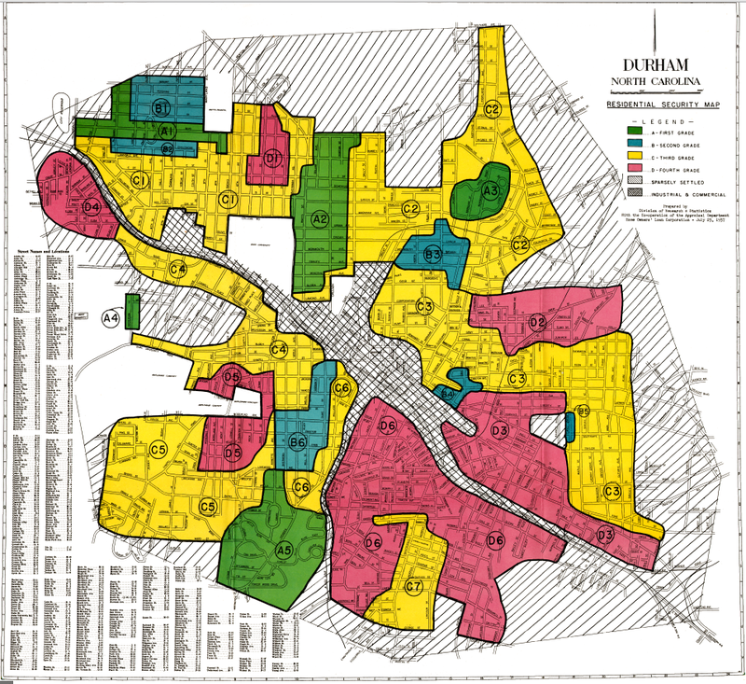
Structural Differences in Pollution Exposure – Past and Present
People’s World
National Archives
University of Michigan

Slide 4
Research Question
Do power plants over pollute in areas with
higher concentrations of socioeconomic minorities?
Contextualizing Environmental Equity Via
An expanded set of socioeconomic controls
Contiguous time series data
Stationary electric utilities

Slide 5
the Literature
Paper
Relation to study
Improvements Within Study
Mennis and Jordan (2005): The Distribution of Environmental Equity: Exploring Spatial Nonstationarity in Multivariate Models of Air Toxic Releases
Insights into the inequitable distribution of pollution throughout the United States
Estimating changes in pollution nationally using an IV approach
Demographic characteristics not interpolated from other sources
Improved sampling methods
Additional pollution measures
Baryshnikova (2010): Pollution Abatement and Environmental Equity
Theoretical and empirical frameworks for modeling pollution
Park and Kwan (2017): Multi-Contextual Segregation and Environmental Justice Research
Improving socioeconomic controls to account for an expanded view of environmental equity
Comprehensive set of socioeconomic controls

Slide 6
Data: Pollutants
Pollutant (in lbs) | Mean | Std.Dev. | Min | Max
SO₂ | 16.897 | 11.017 | 0 | 84.67
NO_{x} | 5.944 | 4.732 | 0 | 44.472
PM2.5 | 37.592 | 42.736 | 0 | 340.015
Stationary electric utilities in the contiguous United States
1424 power plants grouped by year within
Coordinate data scraped from the EIA website

Slide 7
Data: American Community Survey
Variable | Mean | Std.Dev. | Min | Max
Blue Collar | .294 | .057 | 0 | .736
Pink Collar | .361 | .024 | 0 | .507
Black | .127 | .111 | 0 | .749
Asian | .036 | .039 | 0 | .378
Other | .077 | .062 | 0 | .847
Income < 35K | .345 | .067 | .101 | .658
Median Household Income | 13.05 | 2.834 | 0 | 39.562
Education at most a High School | .291 | .049 | 0 | .498
Income:Poverty < 1 | .153 | .039 | 0 | .49
Child | .237 | .024 | .065 | .401
Elderly | .139 | .027 | .03 | .355
Socioeconomic demographics at the census tract level
Radii constructed: 25, 50, 75, and 100 miles
Centroid coordinates calculated utilizing 2010 census tabulations

Slide 8
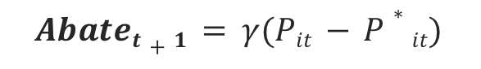
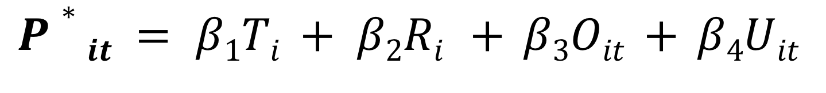
A Theoretical Model Governing Pollution Production
$$P∗it = β1Ti + β2Ri + β3Oit + β4Uit$$
(1)
$$Abatet+1 = γ(Pit − P∗it)$$
(2)
$$Pit + 1 = Pit − Abateit+1$$
(3)
(4)
$$Pit + 1 = γ(β1Ti + β2Ri) + (1− γ ) Pit + β3Oit + γ β4Uit$$
$$∆Pit + 1 = (1− γ ) ∆Pit + γ β3(∆O)it + γ β4 (∆U)it$$
(5)
(6)
$$∆Pit + 1 = (1− γ ) ∆Pit + ∆εit$$

Slide 9
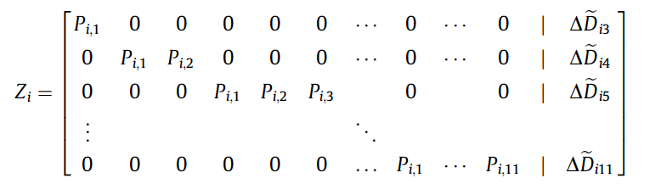
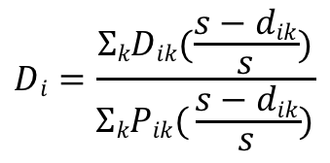
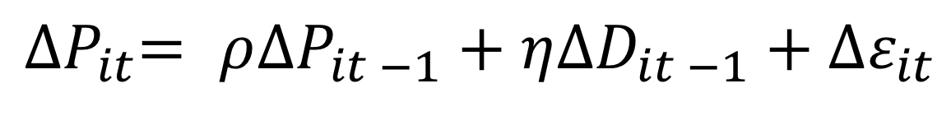
Empirical Strategy
$${∆P}_{it}= ρ{∆P}_{it −1}+η{∆D}_{it −1}+{∆ε}_{it}$$
$$Di=\frac{ΣkDik(\frac{s−dik}{s})}{ΣkPik( \frac{s−dik}{s})}$$
D = demographic characteristic
d = distance between plant and census tract
k = census tract
P = population density
s = radius

Slide 10
Estimations: SO₂
Variables | OLS | Fixed Effects | GMM
AR(1) |  |  | 0.56***
 |  |  | (0.13)
Blue Collar | -0.01 | 3.55 | -7.88***
 | (0.01) | (15.97) | (1.10)
Pink Collar | 0.12*** | 0.67 | -2.17**
 | (0.01) | (8.16) | (1.07)
Black | -0.02*** | 20.51 | 10.02***
 | (0.00) | (30.82) | (1.93)
Asian | 0.08*** | 0.88 | -7.74***
 | (0.01) | (72.14) | (1.77)
Other | -0.01 | 9.63 | -2.96***
 | (0.01) | (8.93) | (0.65)
Less than 35K Income | 0.28*** | -1.96 | 1.29*
 | (0.01) | (15.04) | (0.67)
Median Household Income | 0.00*** | 0.13 | 0.07***
 | (0.00) | (0.29) | (0.01)
At Most HS Education | 0.04*** | 16.39 | 3.82***
 | (0.01) | (30.60) | (1.26)
Income:Poverty Ratio <1 | -0.32*** | 8.76 | 1.80**
 | (0.02) | (6.60) | (0.80)
Child | 0.11*** | 2.62 | -0.58
 | (0.02) | (30.23) | (1.49)
Elderly | -0.35*** | -2.18 | -6.81***
 | (0.01) | (29.74) | (1.53)
Constant | -0.05*** |  | 0.03***
 | (0.01) |  | (0.01)
Cragg – Donald Wald F Statistic |  | 0.023 | 4.113
Hansen p-value |  | Exactly identified | 0.0424
R Squared | 0.12 | -18.80 | -3.73
Valid Instruments: Black, Asian, Income, Child, Elderly
Abatement: 56% of SO₂
Notes:
i) Weighted regressions, standard errors clustered at Plant level
ii) * p$<$0.10, ** p$<$0.05, *** p$<$0.01
iii) GMM specification contains spatially lagged instruments constructed from data within 50-100 miles of a plant; temporally lagged instruments are constructed utilizing the second lag of demographic characteristics

Slide 11
Estimations: NO_{x}
Variables | OLS | Fixed Effects | GMM
AR(1) |  |  | 0.61***
 |  |  | (0.14)
Blue Collar | -0.03*** | 4.93 | -6.16***
 | (0.01) | (16.71) | (1.01)
Pink Collar | 0.09*** | -0.39 | -1.80*
 | (0.01) | (8.35) | (1.04)
Black | -0.01*** | 24.55 | 5.76***
 | (0.00) | (32.13) | (1.63)
Asian | 0.09*** | 0.87 | -3.97**
 | (0.01) | (75.48) | (1.62)
Other | -0.01* | 9.43 | -3.56***
 | (0.01) | (9.54) | (0.62)
Less than 35K Income | 0.15*** | -2.03 | 2.08***
 | (0.01) | (14.96) | (0.60)
Median Household Income | 0.00*** | 0.11 | 0.08***
 | (0.00) | (0.29) | (0.01)
At Most HS Education | 0.07*** | 16.69 | 3.07***
 | (0.01) | (31.94) | (1.17)
Income:Poverty Ratio <1 | -0.16*** | 8.99 | 1.05
 | (0.02) | (7.12) | (0.72)
Child | 0.07*** | 4.00 | -1.36
 | (0.01) | (31.93) | (1.45)
Elderly | -0.25*** | -0.67 | -7.29***
 | (0.01) | (30.61) | (1.47)
Constant | -0.03*** |  | 0.03***
 | (0.01) |  | (0.01)
Cragg – Donald Wald F Statistic |  | 0.052 | 3.819
Hansen p-value |  | Exactly identified | 0.0487
R Squared | 0.07 | -27.41 | -3.46
Valid Instruments: Black, Asian, Income, Education, Child, Elderly
Abatement: 39% of NO_{x}
Notes:
i) Weighted regressions, standard errors clustered at Plant level
ii) * p$<$0.10, ** p$<$0.05, *** p$<$0.01
iii) GMM specification contains spatially lagged instruments constructed from data within 50-100 miles of a plant; temporally lagged instruments are constructed utilizing the second lag of demographic characteristics

Slide 12
Estimations: PM2.5
Variables | OLS | Fixed Effects | GMM
AR(1) |  |  | 0.81***
 |  |  | (0.13)
Blue Collar | -0.04*** | 1.63 | -4.31***
 | (0.01) | (9.10) | (0.59)
Pink Collar | 0.07*** | 0.40 | -1.21**
 | (0.01) | (4.71) | (0.55)
Black | -0.01*** | 10.02 | 4.31***
 | (0.00) | (17.55) | (1.27)
Asian | 0.01* | 0.34 | -3.56***
 | (0.01) | (41.49) | (1.05)
Other | -0.01 | 5.67 | -1.71***
 | (0.00) | (5.03) | (0.34)
Less than 35K Income | 0.21*** | -1.61 | 1.12***
 | (0.01) | (8.80) | (0.34)
Median Household Income | 0.00*** | 0.07 | 0.04***
 | (0.00) | (0.17) | (0.01)
At Most HS Education | 0.04*** | 9.27 | 1.89***
 | (0.01) | (17.42) | (0.66)
Income:Poverty Ratio <1 | -0.27*** | 5.49 | 0.20
 | (0.01) | (3.69) | (0.44)
Child | 0.10*** | 1.15 | 0.89
 | (0.01) | (17.35) | (0.80)
Elderly | -0.27*** | -2.24 | -2.37***
 | (0.01) | (17.17) | (0.84)
Constant | -0.02*** |  | 0.01
 | (0.00) |  | (0.01)
Cragg – Donald Wald F Statistic |  | 0.051 | 3.660
Hansen p-value |  | Exactly identified | 0.0064
R Squared | 0.18 | -15.18 | -2.29
Valid Instruments: Asian, Income, Child, Elderly
Abatement: 19% of PM2.5
Notes:
i) Weighted regressions, standard errors clustered at Plant level
ii) * p$<$0.10, ** p$<$0.05, *** p$<$0.01
iii) GMM specification contains spatially lagged instruments constructed from data within 50-100 miles of a plant; temporally lagged instruments are constructed utilizing the second lag of demographic characteristics

Slide 13
Key Findings and Implications
Abatement rates are very sluggish
Racialized pollution discrepancies are substantial
Limited education access and lower income connote lower air quality
What lies ahead
Limitations…
And Improvements!
Zayrha Rodriguez / The Daily Tar Heel

Slide 14
Appendix

Slide 15
So₂ First Stage F-Statistics
Fixed Effects
GMM
 | Overidentification |  | Weak
 | SW Chi-sq( 1) | P-val | SW F( 1, 1423)
Blue Collar | 0.55 | 0.4571 | 0.55
Pink Collar | 0.39 | 0.5309 | 0.39
Black | 0.5 | 0.48 | 0.5
Asian | 0.39 | 0.5334 | 0.39
Other | 0.59 | 0.4432 | 0.59
Less than 35K Income | 0.37 | 0.543 | 0.37
Median Household Income | 0.47 | 0.494 | 0.47
At Most HS Education | 0.54 | 0.4619 | 0.54
Income:Poverty Ratio <1 | 0.34 | 0.559 | 0.34
Child | 0.41 | 0.5243 | 0.4
Elderly | 0.44 | 0.5072 | 0.44
 | Overidentification |  | Weak
 | SW Chi-sq( 1) | P-val | SW F( 1, 1423)
Blue Collar | 69.66 | 0 | 5.78
Pink Collar | 71.64 | 0 | 5.95
Black | 174.73 | 0 | 14.51
Asian | 354.23 | 0 | 29.42
Other | 66.45 | 0 | 5.52
Less than 35K Income | 177.4 | 0 | 14.73
Median Household Income | 107.97 | 0 | 8.97
At Most HS Education | 119.5 | 0 | 9.92
Income:Poverty Ratio <1 | 90.72 | 0 | 7.53
Child | 197.34 | 0 | 16.39
Elderly | 170.4 | 0 | 14.15

Slide 16
NO_{x} First Stage F-Statistics
Fixed Effects
GMM
 | Overidentification |  | Weak
 | SW Chi-sq( 1) | P-val | SW F( 1, 1423)
Blue Collar | 0.46 | 0.4982 | 0.46
Pink Collar | 0.83 | 0.3628 | 0.83
Black | 3.69 | 0.0547 | 3.68
Asian | 0.53 | 0.4673 | 0.53
Other | 0.6 | 0.4371 | 0.6
Less than 35K Income | 0.66 | 0.4156 | 0.66
Median Household Income | 0.55 | 0.4574 | 0.55
At Most HS Education | 0.46 | 0.498 | 0.46
Income:Poverty Ratio <1 | 1.33 | 0.2494 | 1.32
Child | 0.53 | 0.4667 | 0.53
Elderly | 0.57 | 0.4489 | 0.57
 | Overidentification |  | Weak
 | SW Chi-sq( 1) | P-val | SW F( 1, 1423)
Blue Collar | 68.73 | 0 | 5.71
Pink Collar | 68.26 | 0 | 5.67
Black | 213.6 | 0 | 17.74
Asian | 326.66 | 0 | 27.13
Other | 61.41 | 0 | 5.1
Less than 35K Income | 212.23 | 0 | 17.62
Median Household Income | 109.72 | 0 | 9.11
At Most HS Education | 126.29 | 0 | 10.49
Income:Poverty Ratio <1 | 87.06 | 0 | 7.23
Child | 177.71 | 0 | 14.76
Elderly | 187.7 | 0 | 15.59

Slide 17
PM2.5 First Stage F-Statistics
Fixed Effects
GMM
 | Overidentification |  | Weak
 | SW Chi-sq( 1) | P-val | SW F( 1, 1423)
Blue Collar | 0.46 | 0.4989 | 0.46
Pink Collar | 0.81 | 0.3672 | 0.81
Black | 3.7 | 0.0544 | 3.69
Asian | 0.52 | 0.4688 | 0.52
Other | 0.6 | 0.4392 | 0.6
Less than 35K Income | 0.65 | 0.4184 | 0.65
Median Household Income | 0.55 | 0.4596 | 0.55
At Most HS Education | 0.46 | 0.4997 | 0.45
Income:Poverty Ratio <1 | 1.33 | 0.248 | 1.33
Child | 0.53 | 0.468 | 0.53
Elderly | 0.57 | 0.4508 | 0.57
 | Overidentification |  | Weak
 | SW Chi-sq( 1) | P-val | SW F( 1, 1423)
Blue Collar | 84.78 | 0 | 7.04
Pink Collar | 71.92 | 0 | 5.97
Black | 111.35 | 0 | 9.25
Asian | 244.16 | 0 | 20.28
Other | 70.36 | 0 | 5.84
Less than 35K Income | 178.76 | 0 | 14.85
Median Household Income | 119.61 | 0 | 9.93
At Most HS Education | 118.62 | 0 | 9.85
Income:Poverty Ratio <1 | 96.1 | 0 | 7.98
Child | 180.72 | 0 | 15.01
Elderly | 135.92 | 0 | 11.29

